Slide 1
Getting Unstuck:
Keeping Your Plans Moving Forward
Jason C. Stearns, IGP, CIPP/US, CRM

Slide 2
Learning Objectives
Upon completing this session, you will be able to:
Analyze the needs and issues of the key stakeholders necessary to move forward
Develop the "art" of compromising while staying true to yourself and your goals
Examine ways to partner with and leverage supportive stakeholders
Identify action steps to move forward and get back on track
Apply techniques of "self-care" to keep you and your team motivated

Slide 3
The scenario:
You've been drafting and socializing your project for months.
Key players are on board. You've reviewed the entire project with senior leadership for final executive sign-off and… nothing. There's lots of discussion and review, but still no progress.
The project is stuck! You're stuck. Now what?
Whether you have a specific project or a large scale initiative, this session will show you the tools, techniques, and approaches for getting your plans (and you) "unstuck" and back on track.

Slide 4
Getting Unstuck: The SIX Phase Model
Fundamentals
Contribution
Misery
Renewal
Wisdom
Excitement
Introspection + Redirection + Action = Traction

Slide 5
Analyze the needs and issues of the key stakeholders necessary to move forward

Slide 6
Analyze the needs of the key stakeholders
Learn how to increase your success by recruiting stakeholders who have a vested interest in the effort both directly and indirectly.
What do we mean by stakeholders and their interests?
Why identify and analyze stakeholders and their interests?
Who are potential stakeholders?
When should you identify stakeholders?
How do you identify and analyze stakeholders and their interests?

Slide 7
Who are the IG Stakeholders?
Notes:
Records Management – develops policies, procedures and guidelines focusing on managing information and records throughout their lifecycle
Information Technology – develops and maintains computing and networking infrastructure, plans data migration, develops and manages data backup strategies
Information Security – develops policies, plans and strategies to prevent and react to unauthorized data disclosure, establishes rules for and monitors information sharing and access
Risk Management – identify, assess, and recommend actions to mitigate internal and external risks associated with information collection, handling and processing
Compliance – align policies, procedures, operations etc. with the organization’s regulatory and compliance requirements, coordinate regulatory review and monitoring
Legal – align policies, procedures, operations etc. with the organization’s legal obligations, coordinate discovery for inquiries, provide interpretation and guidance on laws and regulations
Privacy – develops policies, plans and strategies to protect PII, SPII, MNPI, and other forms of sensitive information, reviews information sharing and access for privacy compliance
Business Groups – review policies, plans and strategies to assess impact on operations, provide insight into information usage and needs, propose new strategies, projects, applications, etc.

Slide 8
Develop the "art" of compromising while staying true to yourself and your goals

Slide 9
Compromising while staying true to yourself
By staying true to yourself you will be more likely to achieve great results.
Here are 5 strategies for staying true to yourself and being more assertive in your relationships…

Slide 10
Compromising while staying true to yourself
By staying true to yourself you will be more likely to achieve great results.
Here are 5 strategies for staying true to yourself and being more assertive in your relationships…
Never sacrifice your identity to other people.
Notes:
Never sacrifice your identity to other people.
Being in a relationship is not easy.
It doesn’t matter if it’s a friendship, romantic relationship, or family relationship.
Either way, things can get hard.
Over time, more and more conflicts happen.
As a result, it’s easy to stop standing up for yourself.
It’s easy to stop doing what you want to do just to keep the peace.
It’s easy to lose your identity.
Too many people sacrifice who they are at their core just to keep other people from going berserk.
These people falsely assume that by keeping the peace, they’re doing the right thing.
They think that killing the fight inside of them is the moral thing to do.
Nothing could be further from the truth.
Killing the fight inside of you is not self-sacrifice, it’s self-destruction.
By rolling over again and again, you don’t become stronger, you become a former shell of yourself.
Don’t make the mistake of changing who you are just to please others.
Don’t make the mistake of shying away from adversity.
Keep yourself in check by asking, “What do I really want?” and “Is this what the real me would do, or what the fake me would do?”

Slide 11
Compromising while staying true to yourself
By staying true to yourself you will be more likely to achieve great results.
Here are 5 strategies for staying true to yourself and being more assertive in your relationships…
Set strict boundaries with your time and space.
Notes:
Set strict boundaries with your time and space.
When you have to pay bills, meet obligations, and provide for others, it’s hard to find time for yourself.
Not only is it hard to find alone time, it’s hard to feel like it’s okay to be alone.
Too many people feel guilty for spending time alone.
They feel selfish for making room for their own thoughts, desires, and actions.
The problem with this is that the quality of your alone time determines the quality of your relationships.
If you’re not mentally and physically at 100% , you can’t be there for others 100%.
Instead, you can only kind of be there.
The value you add to yourself is proportional to the value you can add to your relationships.
Start protecting your time.
Start protecting your space.
Realize that you need time and space for relaxation, reflection, and improvement.
If you’re always busy giving your time and space to other people, you’ll never grow.
You’ll never get better.
You’ll never be able to give more.
By refusing to take time and space for yourself, you’re doing everyone else a disservice by giving them a tired, unfocused, and stagnant version of yourself.

Slide 12
Compromising while staying true to yourself
By staying true to yourself you will be more likely to achieve great results.
Here are 5 strategies for staying true to yourself and being more assertive in your relationships…
Don’t be needy and don’t accept someone else’s needy behavior.
Notes:
Don’t be needy and don’t accept someone else’s needy behavior.
You are not responsible for other people’s happiness.
When grown men and grown women try to make you feel guilty for not spending time with them or not doing what they want, it’s simply a power play.
They want to control you.
If you act as a crutch for people like this long enough, your mind will become conditioned to sacrificial thinking.
You’ll start to believe that you have to sacrifice your happiness for others to be happy.
You’ll start to believe that you have to sacrifice your success for others to be successful.
Why can’t you have both?
Why can’t you be happy and other people be happy at the same time without either party having to sacrifice anything?
You and other people can be happy and successful at the same time.
The problem is that some people don’t want to be happy.
Some people want to play the victim instead.
Some people simply want to be lazy.
You’re not responsible for these people.
Let them go.
Stop being their crutch.
Stop sacrificing who you are to them.

Slide 13
Compromising while staying true to yourself
By staying true to yourself you will be more likely to achieve great results.
Here are 5 strategies for staying true to yourself and being more assertive in your relationships…
Don’t feel obligated to care about the same things that someone else cares about.
Notes:
Don’t feel obligated to care about the same things that someone else cares about.
Everyone is NOT obligated to fight for the same cause.
Everyone is NOT obligated to do what you want.
At the same time, you’re not obligated to do what other people want.
You have to decide what’s important to you and stick to it.
If you constantly let other people distract you from your goals in life, you’ll never get anywhere.
If you constantly let other people use drama to steal your attention, you will fail.
Stop feeling obligated to care about other people’s problems.
Stop letting other people make you feel guilty.
Instead, start putting your time and energy towards the things you believe in.
Start feeling obligated to yourself.

Slide 14
Compromising while staying true to yourself
By staying true to yourself you will be more likely to achieve great results.
Here are 5 strategies for staying true to yourself and being more assertive in your relationships…
Refuse to let others train you to be someone you’re not.
Notes:
Refuse to let others train you to be someone you’re not.
Social pressure is a very strong force.
If you want to achieve your individual goals in life, you must guard yourself against having a herd mentality.
Being friends with other people doesn’t mean you have to give them control of your mind.
Being related to other people doesn’t mean you have to think and act like them.
You can choose to be your own person at any time.
The key is staying conscious of the unseen pressures that other people put on you.
Too many people allow their friends, family members, and relationship partners to slowly change them.
They allow these people to train them into being a muddled version of their former selves.
If you are in a setting where others are slowly molding you into being someone you’re not, escape immediately.
Take back your life by backing out of the negative relationship.
Just because you got in a relationship doesn’t mean you have to stay there.
You certainly don’t have to stay there AND be quiet about it.
When asked to be someone you’re not, answer.
Don’t stay quiet.
Say no, but thanks anyway, I’m going to be myself and chase my goals.
Peace out.
There’s great freedom in actively deciding to be who you are at your core.
Many people will try to manipulate you in life.

Slide 15
Examine ways to partner with and leverage supportive stakeholders

Slide 16
Partner with and leverage supportive stakeholders
Five strategies that will help you manage your project’s stakeholders:
Stakeholder mapping
Influence is key
Identify the triggers
Look for opportunities
Proactive mitigation
Notes:
Stakeholder mapping
Early in the project, conduct a thorough stakeholder analysis to identify your stakeholders. Identify and examine key factors including proximity to your project, demographics, interest in the project, needs and concerns, expectations of your project and any previous public statements.
Also important is gaining an understanding of your internal stakeholders, such as immediate staff, suppliers and contractors, broader companies or alliances and shareholders. Mapping your internal stakeholders will allow you to investigate whether you have the right resources and whether your team will function effectively.
Influence is key
Understanding levels of influence will allow you to predict how a particular stakeholder may interact directly with your project team or with others. The range of possible influence is broad, from positive sentiment and support through to activism and engagement of other community members against your project.
To measure the possible influence of your stakeholders, identify their level on a scale ranking from high, medium to low:
High: indicates a stakeholder who has significant power to impact decisions, timeframes, or outcomes.
Medium: indicates a stakeholder with a significant interest in the project, however with a lower level of power to effect project change.
Low: indicates a stakeholder with little ability to change project outcomes.
Identify the triggers
Stakeholders will react in different ways to different project actions, however by identifying triggers and mitigation measures, you can avoid preventable complaints. Often, it is when stakeholders experience changes to their environment or expectations of a business and its behavior that may cause a reaction.
Correlate your stakeholder list with potential known triggers, such as loud or dusty construction works, visual amenity impacts or disruptions to their normal patterns. Estimate the impact that these reactions may have to your project or strategies and identify whether targeted communication, mitigation or an alternative solution is required.
Look for opportunities
From a risk management perspective, it is tempting to focus on those stakeholders most likely to cause disruption to the project. Equally important are those stakeholders who view your project favorably or may benefit from it. Identify these stakeholders and investigate opportunities to leverage their positive perception as project advocates.
Proactive mitigation
With a solid understanding of your stakeholders, their influence and triggers, the next step is to develop a mitigation plan. This step details the risks you are prepared to accept, share or avoid and outlines how you can reduce their impact.
Identify early what are your negotiables and non/negotiables. This may include minor changes to alignment, preferred noise mitigation measures, differing construction techniques or haulage routes. Working with your stakeholders through this process will also improve project buy-in, credibility and ownership of the mitigation measure.

Slide 17
Identify action steps to move forward and get back on track

Slide 18
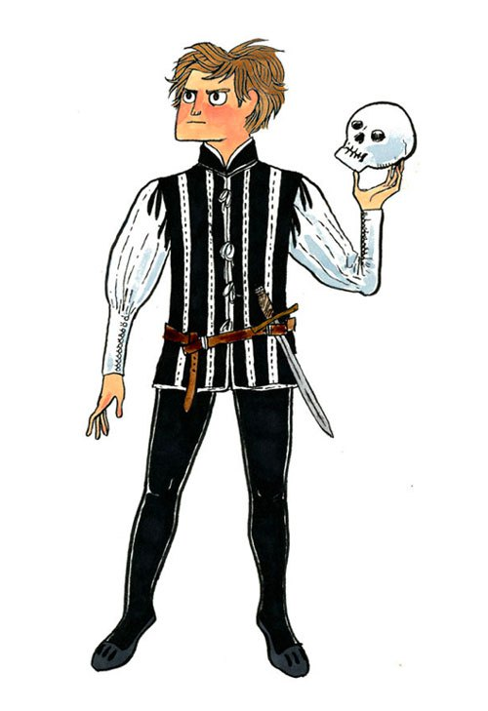
Steps to move forward and get back on track
To Recover or Not to Recover… that is the question!
Notes:
To Recover or Not to Recover:
It could be worth exploring whether or not there is a need to recover in the first place. It could be that the need for the project has changed thus making the project unnecessary. In this case, the project manager should spend some time talking with the project sponsors to determine the viability of the project moving forward. Some key questions that should be addressed in this discussion are:
Has the need for the project changed? If so, how? And does it warrant throwing out the old project and starting a new project?
Has the priority for the project changed? If so, should the project be put on hold for some amount of time?
Are there enough funds to continue with the project? If not, how can more funds be allocated, or should the project be halted altogether?

Slide 19
Steps to move forward and get back on track
Work Overtime – but don’t forget the ‘Law of Diminishing Returns’
Notes:
Work Overtime:
No one likes this approach, but if the schedule is that far off track, it may be needed in the interim to turn things around. Project Managers should be forewarned, that with this approach, motivation and morale is likely to drop very quickly if the overtime is extensive and there appears to be no end in sight. With that being said, it would be a good idea to set a time line for how long the overtime is to last. That way, team members can see that their efforts are leading towards a definite purpose and that things will not be hectic forever.
But remember the law of diminishing returns: A study from Stanford found that productivity per hour declines sharply when the workweek exceeds 50 hours, and productivity drops off so much after 55 hours that there’s no point in working any more. That’s right, people who work as much as 70 hours (or more) per week actually get the same amount done as people who work 55 hours.

Slide 20
Steps to move forward and get back on track
Crash the Schedule!
Notes:
Crash the Schedule: In this method, you would apply additional resources to tasks on the critical path in order to shorten the amount of time needed to complete those tasks. According to an article by Microsoft, some of the ways to shorten the critical path, are shortening the duration of a task on the critical path, or changing a task constraint to allow for more scheduling flexibility. It may also be worth considering changing the project management methodology, perhaps considering Critical Chain, or some variant of Agile Project Management.

Slide 21
Steps to move forward and get back on track
Fast track tasks!
Notes:
Fast Track Tasks: With this approach, you would look for tasks that are currently designated to be completed in sequence, and change them to be completed either totally or partially in parallel. The idea behind this approach is that you can complete more in less time. Another approach to fast tracking is known as partial overlapping. With this approach, you find that tasks that could be started right before its predecessor is complete.

Slide 22
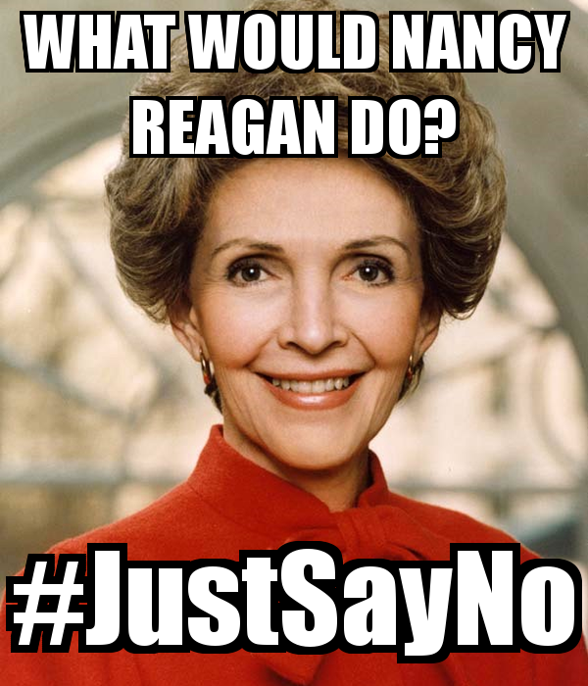
Steps to move forward and get back on track
Just say NO!
To Scope
Change
Image from: https://www.keepcalm-o-matic.co.uk
Notes:
Say No to Scope Change: Scope creep is one of the most damaging things a project faces. With the scope of work constantly changing, it can be like trying to hit a moving target. By saying no to scope change, you give the project team a set goal upon which to concentrate. One of the easiest ways to manage scope creep is create a Scope statement for the project that is agreed upon and signed off on by each of the stakeholders. This scope statement then becomes the measuring stick for whether or not changes fall within the parameter of the original scope of the project.

Slide 23
Steps to move forward and get back on track
Scope Reduction
Notes:
Scope Reduction: Perhaps the initial scope of the project was too large to begin with and can’t really be completed in the time allocated. If this is the case, it may be time to revise the scope and get things to a manageable level. The Project Manager should take the Scope statement back to the stakeholders and determine areas of the scope to either remove or perhaps put off to another phase of the project.

Slide 24
Steps to move forward and get back on track
Outsource
Notes:
Outsource: Replace the project manager and/or bring in outside help. Outside help can, in certain circumstances, act with independence and objectivity. This can help to “clear the air”, realign everyone’s expectations, and get the project back on track.

Slide 25
Apply techniques of "self-care" to keep you and your team motivated!

Slide 26
Stay motivated
Be a cheerleader, not just a coach
Practice empathy
Pile on the positive feedback
Get out of the way
Remember your manners
Keep your door open
Make them part of the mission
Do more yoga
Notes:
Be a cheerleader, not just a coach
“When employees don’t bring their A-games to work, it’s often because they lack confidence in their abilities or don’t even know what they’re capable of achieving. Great leaders bring out greatness in their team because they see what is possible and transfer that belief to their people. Empower your people by letting them know you believe they can achieve their goals, do their best work, take on a new project or land a new client. Often your belief in them will directly affect their confidence in themselves.” —David Dye, author of The Seven Things Your Team Needs to Hear You Say and co-author of Winning Well: A Manager’s Guide to Getting Results — Without Losing Your Soul, based in Denver
Practice empathy
“The old-school management technique of using negative reinforcement to drive results has been proven ineffective, and it also creates an unhealthy work environment for everyone. By leading your team with support and empathy, you will build a stronger relationship and increased rapport with your team. Your employees will step up to the plate and deliver at the next level.” —Dandan Zhu, CEO and Founder of Dandan Global, a career coaching service in New York City
Prioritize their health
“Healthier employees tend to have more endorphins flowing, work harder, get more done in many cases and feel happier. Offer healthy snacks in the break room, and encourage employees to take smoke-free breaks and get outside twice a day. If possible, offer [to subsidize] their gym memberships if they go at least 10 times a month.” —Jess Tiffany, president of Marketing and Networking University in Minneapolis
Pile on the positive feedback
“Overwhelm them with positive feedback—on the big things, little things, any chance you get. Most managers only give feedback when it’s negative or corrective, but they don’t give out the good stuff nearly as much as they think they do. Give at least three pieces of positive feedback for every piece of negative feedback.” —Karlyn Borysenko, principal at Zen Workplace in Boston
Get out of the way
“Leave employees alone. That might sound counterintuitive, but backing off is a great—and underutilized—way of motivating your team. Top performers want space to be their best, all the while feeling a real sense of trust from above.” —Lori Scherwin, founder of Strategize That in New York City
Remember your manners
“Saying ‘please’ and ‘thank you’ go a long way. Saying ‘thank you’ is a specific and tangible way of letting your staff know that you know how much effort was put into the work being done and that you recognize the value of that effort. Employees who believe their work has value tend to take pride in what they are doing. They tend to want to contribute more, and the quality of their work is improved.” —Erica B. McCurdy, managing member of McCurdyLifeCoach.com in Atlanta
Keep your door open
“Proactively demonstrate your eagerness to support your team by maintaining a regular schedule of one-on-one time. When impromptu requests come up, regardless of how the day has gone or the deadlines looming, view it as an opportunity to empower your team members through feedback and support.” —Kendra Davies, owner of Stellar Life Coaching in Orlando
Make them part of the mission
“Make sure your leadership is aligned with the vision of the organization and that this vision is featured prominently and enthusiastically in all your leadership communications with your team. When employees have clarity and unity around their company's purpose, they understand how to prioritize their work, and they avoid wasting time on unfulfilling, inconsequential tasks. More importantly, they can see how the work they do each day contributes to something bigger and directly helps to advance the organization's goals.” —Seth Sinclair, leadership coach and co-founder of Modern da Vinci in Washington, D.C.
Do more yoga…
Or go to the gym, or to a book club, volunteer, make time for family… do what you need to do to unplug. – Jason Stearns
“Lead by example and implement self-care and stress management on a personal level, and encourage these strategies among employees. ‘Walking the talk’ will help you to build authentic relationships grounded in trust. This in turn will lead to a cohesive team, who work together well and find new ways of keeping stress in check” – Tina Hogg, Director and Co-owner of Saltuary; a holistic natural health partner in Five Dock, Sydney.

Slide 27
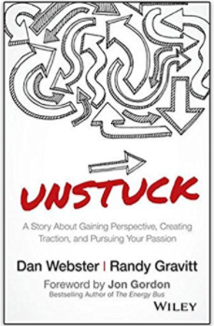
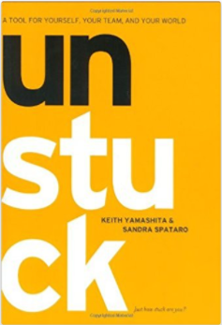
Additional Resources…

Slide 28
Thank you
Jason C. Stearns, CRM, IGP, CIPP/US jasonstearns.arma@gmail.com linkedin.com/in/jasoncstearnscrm

